Slide 1
MS Access
Lab 24: Introduction to MS Access

Slide 2


Welcome to MS Access Class

Slide 3

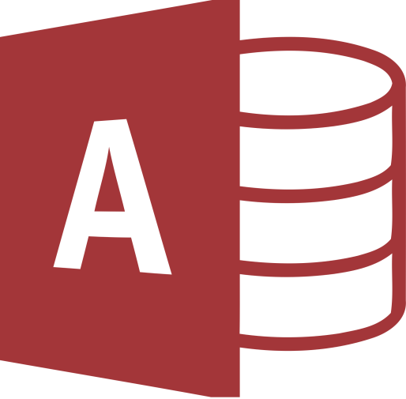
What is MS Access?
Microsoft Access is a Database Management System (DBMS) from Microsoft.
It is a Relational Database Management System (RDBMS), designed primarily for home or small business use.

Slide 4
MS Access
Can import data stored in other applications and databases.
Can export data to and import data from word processing files, spreadsheets, or database files directly.
Can work databases that support the Open Database Connectivity (ODBC) standard, including SQL Server, Oracle, and DB2.
Software developers Can use Microsoft Access to develop application software.

Slide 5
MS Access VS Excel?
Microsoft Access stores various types of data in a way that is easy to retrieve. It includes various features in order to achieve this.
Excel, on the other hand, leans more towards numerical data and performing calculations on that data.
Access allows you to restrict the data that users enter into each field .
While you can certainly store various types of data in an Excel spreadsheet

Slide 6
Version
MS Access 2016
MS Access 2013
MS Access 2003

Slide 7

Database Creation
Create your Microsoft Access database and specify what kind of data you will be storing.

Slide 8
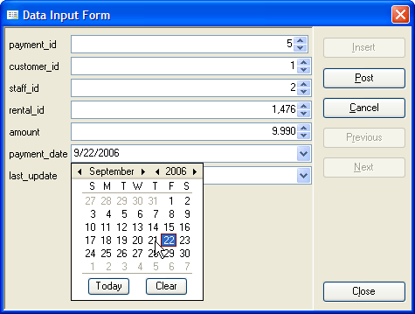
Data Input
After your database is created, the data of every business day can be entered into the Access database.

Slide 9

Query
This is a fancy term to basically describe the process of retrieving information from the database.

Slide 10
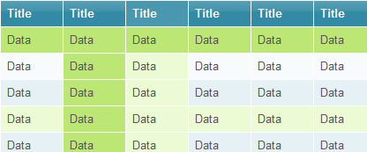
Report
Information from the database is organized in a nice presentation that can be printed in an Access Report.

Slide 11
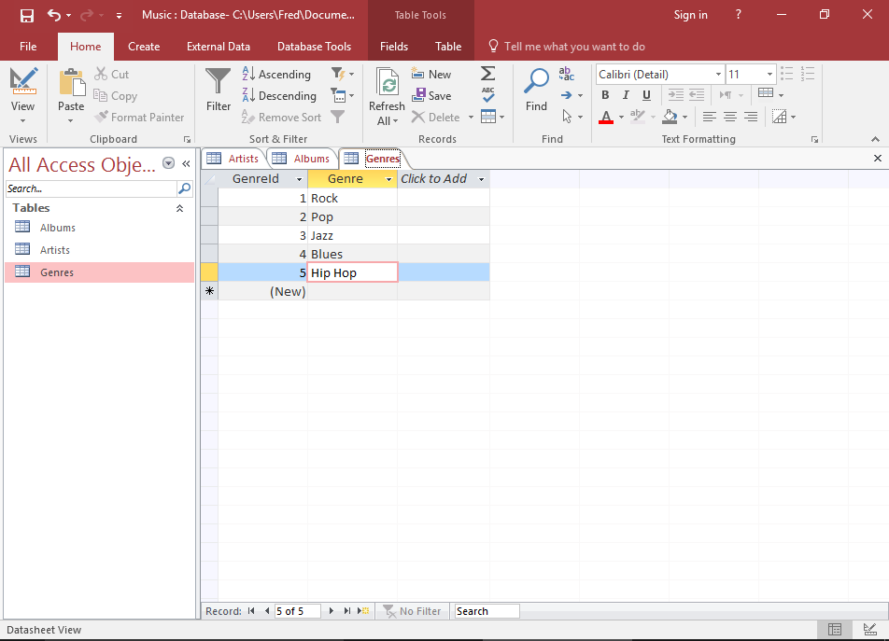
MS Access Interface

Slide 12

Thank You!

